Slide 1

Machine Learning Model to Predict Creditworthiness of Borrowers
Yasitha De Alwis
ydealwis@gmail.com
Git Hub : @yasiSriLanka
Linkedin: https://www.linkedin.com/in/yasitha-de-alwis/

Slide 2
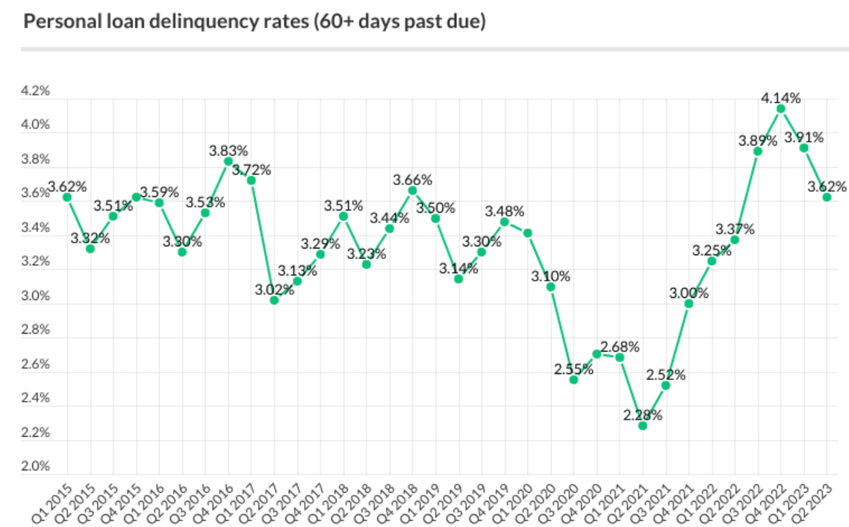
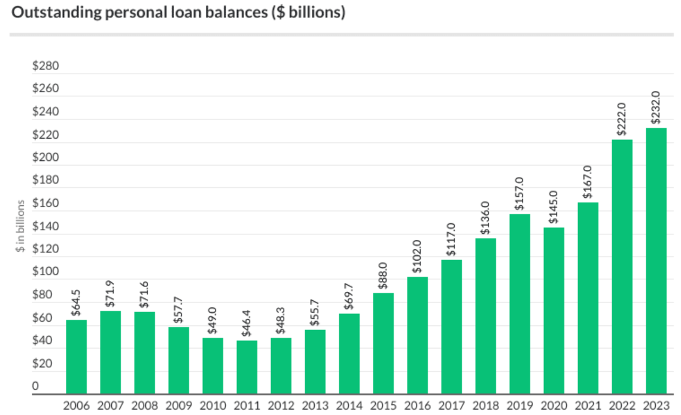
Key Facts
22.7 million Americans owe $232 billion in personal loans
Personal debt doubled over last 5 years
On average default rates are 3.5% - 4%
Most borrowers (51%) take out a personal loan to pay down debt i.e. consolidate debt or refinance credit cards.
Source : The Wall Street Journal and TransUnion

Slide 3

Business Understanding
Scientific assessment of creditworthiness of potential borrowers
Maintain a healthy loan portfolio
Overall stability of the financial system
Objective
Model to Predict Creditworthiness

Slide 4
Data Overview
Kaggle dataset on personal loan portfolio
Data Source
500 K
Train Data 300K
Test Data 125K
Validation Data 75K
No of Records
26
Numerical Data : 16
Categorical Data : 9
Target Variable : Creditworthy/not
No of Variables
Annual loan installment
Loan installment to income ratio
Loan to income ratio
Feature Engineering
3

Slide 5
Model Development Process
Data Clensing & Missing Values
Model Finalization and performance on unseen data
06
01
05
Model Evaluation
Feature Engineering
02
Modeling & Hyper Parameter tuning
04
03
Define pipelines for Transformations

Slide 6
Model Performance
MODEL | TRAIN SCORE | TEST SCORE | TRAIN LOGLOSS | TEST LOGLOSS | CV WITH F1 SCORE | ACCURACY
Dummy Model | 0.761 | 0.764 | 0.550 | 0.546 | 0.000 | 0.76
Logistic Regression | 0.784 | 0.787 | 0.466 | 0.462 | 0.376 | 0.79
Logistic Reg. with Poly | 0.791 | 0.794 | 0.451 | 0.447 | 0.424 | 0.79
Gradient Boost | 0.788 | 0.789 | 0.458 | 0.454 | 0.300 | 0.79
XG Boost | 0.859 | 0.822 | 0.331 | 0.400 | 0.526 | 0.82
XG Boost with SMOTE | 0.846 | 0.821 | 0.357 | 0.402 | 0.530 | 0.82
Random Forest | 0.778 | 0.776 | 0.458 | 0.474 | 0.132 | 0.78
RF with SMOTE | 0.735 | 0.725 | 0.533 | 0.544 | 0.486 | 0.72
K-Neighbors | 0.792 | 0.771 | 0.443 | 0.695 | 0.287 | 0.77
Stacking (XG Boost & lr) | 0.860 | 0.821 | 0.333 | 0.405 | 0.538 | 0.82
Stacking (XG Boost & RF) | 0.861 | 0.821 | 0.331 | 0.405 | 0.537 | 0.82
Stacking (XG Boost,RF & lr) | 0.860 | 0.821 | 0.333 | 0.405 | 0.539 | 0.82

Slide 7
Model Selection

Slide 8
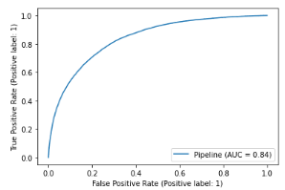
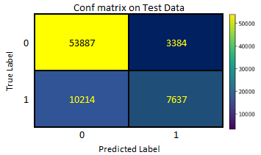
Final Model Performance
Train Score 0.8535
Test Score 0.819
Log-Loss on Train data 0.3392
Log-Loss on Test data 0.402
Accuracy 0.82
Precision 0.69
Recall 0.43
f1-Score 0.53
Train-Test &
Log-Loss Score
Classification
Summary
Area Under
ROC Curve
Confusion
Matrix

Slide 9

Recommendation
DefaultShield : XG Boost Classifier
booster='gbtree'
learning_rate=0.1
max_depth=10
n_estimators = 175
reg_lambda =1
colsample_bytree=0.5
subsample=0.8

Slide 10

Next Steps
Consider macro-economic factors
Extend data for better performance
Regular update of the model
Implementation of the model in user friendly environment

Slide 11

Thank You
Github repository for workings
Yasitha De Alwis
ydealwis@gmail.com
Github : @yasiSriLanka
Linkedin: https://www.linkedin.com/in/yasitha-de-alwis/

